Slide 1
Magenic Masters React Introduction
Jan 17, 2017
Mily Opena

Slide 2
What You’ll Learn
What is React
Thinking in Components
Virtual DOM
JSX

Slide 3
Why Learn React?

Slide 4

Why Learn React?
Small Learning Curve

Slide 5

Why Learn React?
React is Fast

Slide 6
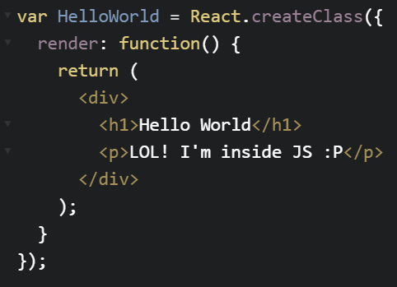
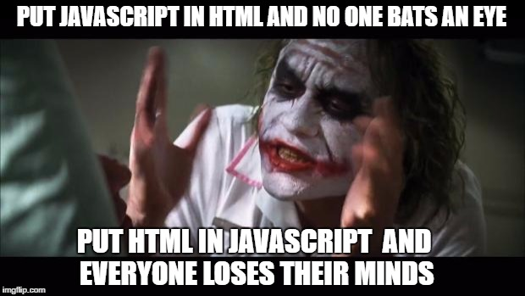
Why Learn React?
JSX

Slide 7









Why Learn React?
Great Community, Battle Tested

Slide 8

Why Learn React?
Encapsulated Components
Codes are easier to reason about
Learn once, write everywhere
It pays well

Slide 9
Lets start Reacting ☺

Slide 10
Meet React

Slide 11
Meet React
A library for creating user interfaces
It’s just the V in MVC

Slide 12
Meet React
Declarative
Code is more predictable and easier to debug

Slide 13
Meet React
Component based
Build small component, compose complex UI

Slide 14
Meet React
Plays nicely with your stack
Learn once, write anywhere

Slide 15
Meet React
One-way data binding
Renders UI and respond to events

Slide 16
Meet React
React Syntax Demo
“Hello React”

Slide 17
Meet Components

Slide 18
Meet Components
We all like separation of concerns, right?
Reduce coupling, increase cohesion

Slide 19
Meet Components
Coupling
The degree to which software components
are dependent upon each other

Slide 20
Meet Components
Cohesion
The degree to which the elements of a module belong together

Slide 21
Meet Components
Templates separate technologies,
not concerns

Slide 22
Meet Components
Display logic and markups are inevitably tightly coupled
How do you bind to DOM element?

Slide 23
Meet Components
Use React components to separate your concerns
React components are reusable
React components can be nested

Slide 24
Meet Components
React components are self-contained, concern-specific building blocks
React favors the creation of simple reusable components

Slide 25
Meet Components
Since React components are concern-specific, it is easy to unit test
After all, a component is a unit

Slide 26
Meet Components
Think in component as React developer
In React application, everything is made of components

Slide 27
Meet Components
Demo
“Shopping List”

Slide 28
Meet Virtual DOM

Slide 29
Meet Virtual DOM
In 90’s it was easier
Just refresh the page when the data changes

Slide 30
Meet Virtual DOM
In React, when the data changes, React re-renders the entire component
Every place data is displayed is guaranteed to be up-to-date

Slide 31
Meet Virtual DOM
Re-rendering on every change makes things simple
No more magical data-binding
No more dirty-checking
No more explicit DOM operations

Slide 32
Meet Virtual DOM
“Re-render on every change? That seems expensive”

Slide 33
Meet Virtual DOM
Virtual DOM
Makes re-rendering on every change fast

Slide 34
Meet Virtual DOM
You can’t just throw out the DOM and rebuild it on each update
It’s too slow

Slide 35
Meet Virtual DOM
So Facebook built a Virtual DOM
Optimized for performance and memory

Slide 36
Meet Virtual DOM
On every update…
React builds a new virtual DOM subtree
Diffs it with the browser DOM
Computes the minimal set of DOM mutations and puts them in a queue
Batch executes all updates

Slide 37
Meet Virtual DOM
It’s fast!
Manipulating the in-memory representation of DOM is faster
than manipulating the real DOM

Slide 38
Meet Virtual DOM
Demo
“Angular vs React”

Slide 39
Meet JSX

Slide 40
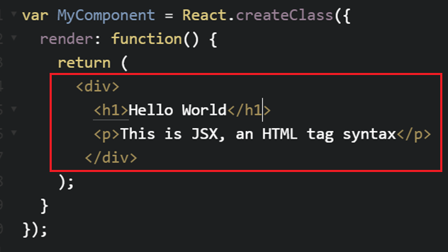

Meet JSX
The funny tag syntax inside React components that is neither string nor HTML

Slide 41
Meet JSX
Perhaps, the most confusing about React isn’t React at all, it’s JSX
But Facebook recommend using it with React

Slide 42
Meet JSX
It is just a syntax extension to JavaScript
Fundamentally, JSX just provides syntactic sugar for the React.createElement() function

Slide 43
Meet JSX
You will eventually become more comfortable using JSX
More details to follow in the coming sessions

Slide 44
Meet JSX
Demo
“babel”

Slide 45
Agenda Next Session
Quiz
Environment Setup
Assignment

